Slide 1
Ch3
IPv4 and IPv6 Header Structure

Slide 2
Packet Header
Packet Headers are affixed to the beginning of all IP packets. You can think of them as being like "shipping labels" pasted on a package.
A Packet Header contains a "from" address called the source address; and a "to" address called the destination address
On IPv4 packets, there is an IPv4 Packet Header. On IPv6 packets, there is an IPv6 Packet Header
An IP packet consists of a header section and a data section

Slide 3
IPv4
The IPv4 Packet Header is 20 bytes long (plus the length of the options field, if any).
There is no official Header Extension mechanism.
The IPv4 packet header consists of 14 fields, of which 13 are required
The 14th field is optional and named: options

Slide 4
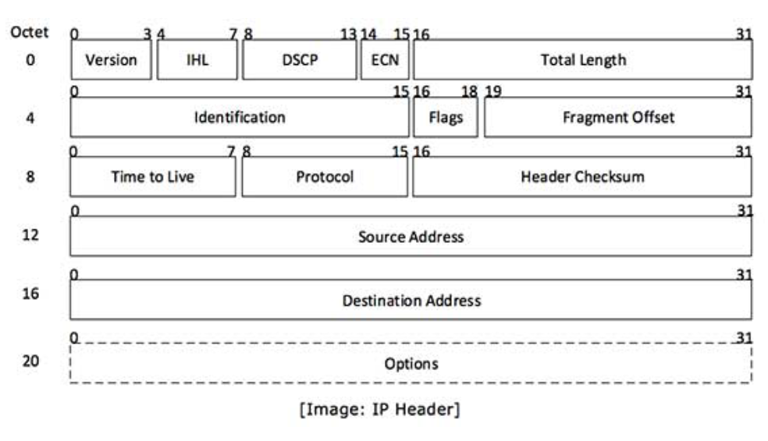
IPv4 Header Structure

Slide 5
IPv4 header includes
Version: Version no. of Internet Protocol used (e.g. IPv4)
IHL: Internet Header Length, Length of entire IP header
DSCP: Differentiated Services Code Point, This is Type of Service.
ECN: Explicit Congestion Notification, carries information about the congestion seen in the route.
Total Length: Length of entire IP Packet (including IP header and IP Payload)
Identification: If IP packet is fragmented during the transmission, all the fragments contain same identification no. to identify original IP packet they belong to.
Flags: As required by the network resources, if IP Packet is too large to handle these ‘flags’ tell that if they can be fragmented or not. In this 3-bit flag, the MSB is always set to ‘0’.

Slide 6
Contd….
Fragment Offset: This offset tells the exact position of the fragment in the original IP Packet.
Time to Live: To avoid looping in the network, every packet is sent with some TTL value set, which tells the network how many routers (hops) this packet can cross. At each hop, its value is decremented by one and when the value reaches zero, the packet is discarded.
Protocol: Tells the Network layer at the destination host, to which Protocol this packet belongs to, i.e. the next level Protocol. For example protocol number of ICMP is 1, TCP is 6 and UDP is 17.
Header Checksum: This field is used to keep checksum value of entire header which is then used to check if the packet is received error-free.
Source Address: 32-bit address of the Sender (or source) of the packet.
Destination Address: 32-bit address of the Receiver (or destination) of the packet.
Options: This is optional field, which is used if the value of IHL is greater than 5. These options may contain values for options such as Security, Record Route, and Time Stamp etc.

Slide 7
IPv6
The IPv6 Packet Header is actually simpler than the IPv4 Packet Header, because some fields were eliminated, and others moved to Extension Headers.
It is twice as large (40 bytes) due to the gigantic (128-bit) source and destination IPv6 addresses (four times the size of IPv4 addresses).
Every bit of the basic IPv6 Packet Header has been accounted for, but it is possible to add any number of new Extension Headers, which didn't exist in IPv4
IPv6 was designed to take an evolutionary step from IPv4
Functions that work in IPv4 were kept in IPv6. Functions that didn't work were removed
IPv6 increases the size of the IP address from 32 to 128 bits. This ensures that the world won't run out of IP addresses. In addition to unicast and multicast addresses, a new type of address, called an anycast address, has also been introduced

Slide 8
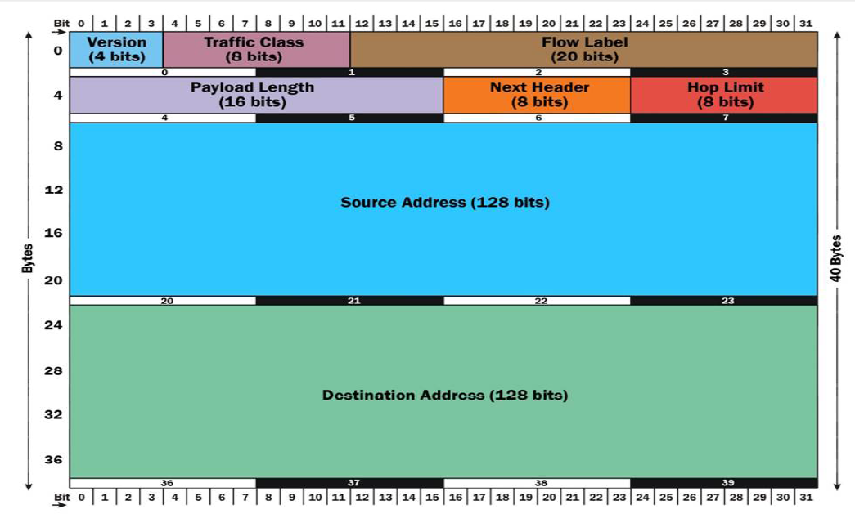
IPv6 Header Structure

Slide 9
IPv6 header includes
Source address (128 bits) : The 128‐bit source address field contains the IPv6 address of The originating node of the packet. It is the address of the originator of the IPv6 packet.
Destination address (128 bits) : The 128‐bit contains the destination address of the recipient node of the IPv6 packet. It is the address of the intended recipient of the IPv6 packet.
Version/IP version (4-bits) : The 4-bit version field contains the number 6. It indicates the version of the IPv6 protocol. This field is the same size as the IPv4 version field that contains the number 4. However, this field has a limited use because IPv4 and IPv6 packets are not distinguished based on the value in the version field but by the protocol type present in the layer 2 envelope
Packet priority/Traffic class (8 bits) : The 8-bit Priority field in the IPv6 header can assume different values to enable the source node to differentiate between the packets generated by it by associating different delivery priorities to them. This field is subsequently used by the originating node and the routers to identify the data packets that belong to the same traffic class and distinguish between packets with different priorities.

Slide 10
Contd….
Flow Label/ QoS management (20 bits) : The 20‐bit flow label field in the IPv6 header can be used by a source to label a set of packets belonging to the same flow.
A flow is uniquely identified by the combination of the source address and of a non-zero Flow label.
Multiple active flows may exist from a source to a destination as well as traffic that are not associated with any flow (Flow label = 0).
The IPv6 routers must handle the packets belonging to the same flow in a similar fashion.
The information on handling of IPv6 data packets belonging to a given flow may be specified within the data packets themselves or it may be conveyed by a control protocol such as the RSVP (Resource reSerVation Protocol).
When routers receive the first packet of a new flow, they can process the information carried by the IPv6 header, Routing header, and Hop‐by‐Hop extension headers, and store the result (e.g. determining the retransmission of specific IPv6 data packets) in a cache memory and use the result to route all other packets belonging to the same flow (having the same source address and the same Flow Label), by using the data stored in the cache memory.

Slide 11
Contd..
Payload length in bytes (16 bits): The 16-bit payload length field contains the length of the data field in octets/bits following the IPv6 packet header. The 16-bit Payload length field puts an upper limit on the maximum packet payload to 64 kilobytes. In case a higher packet payload is required, a Jumbo payload extension header is provided in the IPv6 protocol. A Jumbo payload is indicated by the value zero in the Payload Length field
Next Header (8 bits): The 8‐bit Next Header field identifies the type of header immediately following the IPv6 header and located at the beginning of the data field (payload) of the IPv6 packet. This field usually specifies the transport layer protocol used by a packet‘s payload. The two most common kinds of Next Headers are TCP (6) and UDP (17), but many other headers are also possible.
Time To Live (TTL)/Hop Limit (8 bits): The 8‐bit Hop Limit field is decremented by one, by each node (typically a router) that forwards a packet. If the Hop Limit field is decremented to zero, the packet is discarded. The main function of this field is to identify and to discard packets that are stuck in an indefinite loop due to any routing information errors. IPv6 data packet is allowed a maximum of 255 hops before it is eventually discarded

Slide 12
Differences between IPv4 & IPv6 Packet structure
IPv4 Version field - same size (4 bits), same name, same function, in IPv6 Packet Header.
IPv4 IHL (Internet Header Length) field - discarded since IPv6 Packet Header is fixed length (40 bytes).
IPv4 Type of Service field - same size (8 bits), new name (Traffic Class), same function in IPv6 Packet Header.
IPv4 Total Length field - same size (16 bits), new name (Payload Length), now does not include length of the Packet Header, so new Payload Length = old Total Length – 40.
IPv4 Identification (Fragment ID) field - twice as big (32 bits), same name, same function, moved to Fragmentation Extension Header.
IPv4 DF flag - discarded, effectively always 1 (set) in IPv6.
IPv4 MF flag -same size (1 bit), same name, same function, moved to Fragmentation Extension Header.

Slide 13
Contd….
IPv4 Fragment Offset field - same size (13 bits), same name, same function, moved to Fragmentation Extension Header.
IPv4 Time-To-Live (TTL) field - same size (8 bits), new name (Hop Limit), same function in IPv6 Packet Header.
IPv4 Protocol field - same size (8 bits), new name (Next Header), same function, in IPv6 Packet Header. There is a new set of possible values (some are the same as in the Protocol field in the IPv4 Packet Header, such as values for TCP, UDP and SCTP).
IPv4 Header Checksum field - discarded, considered to be superfluous.
IPv4 Source Address field - new size (128 bits instead of 32), same name, same function, in IPv6 Packet Header.
IPv4 Destination Address field - new size (128 bits instead of 32), same name, same function, in IPv6 Packet Header.
IPv4 Options field - discarded (virtually never used in IPv4 Packet Header) - now Packet Header is fixed length (40 bytes) instead of 20 bytes + length of options field

